Slide 1
Found a Problem?
Enabling Better Feedback to Make Primo Work for You
SUNYLA Midwinter Virtual Conference, Feb. 7, 2020
Christopher Gross and Joscelyn Leventhal, George Washington University Libraries

Slide 2
Introduction
The Need: Enabling Primo users to report problems
Our Solution: The “Found a Problem?” link
Today we will discuss:
What it is
How we set it up (note: it’s a Primo customization)
Our organization and workflow for using it
How it has made things better for us

Slide 3


Who We Are
The George Washington University: a private, nonprofit research university in downtown Washington, DC
The GW Libraries: the main GW library system, separate from the law and medical libraries
The Washington Research Library Consortium: a local consortium of 9 universities that migrated to Alma and Primo VE in July 2018
WRLC was the first consortium to go live with Primo VE
Each WRLC library has its own Alma IZ and its own local Primo Customizations. The Found a Problem link is local to GW Libraries.

Slide 4
Developing the concept
We had already used a link to report problems in our previous link resolvers and EZproxy error messages
Usability testing with both users and staff underlined the need for a link
Testing also showed that any interface element can be overlooked -- we wanted to make it as hard to overlook as possible
Bonus tip: usability testing is strongly recommended!
Our answer was the “Found a Problem?” link: a single, clearly named link that could be repeated throughout the Primo interface

Slide 5
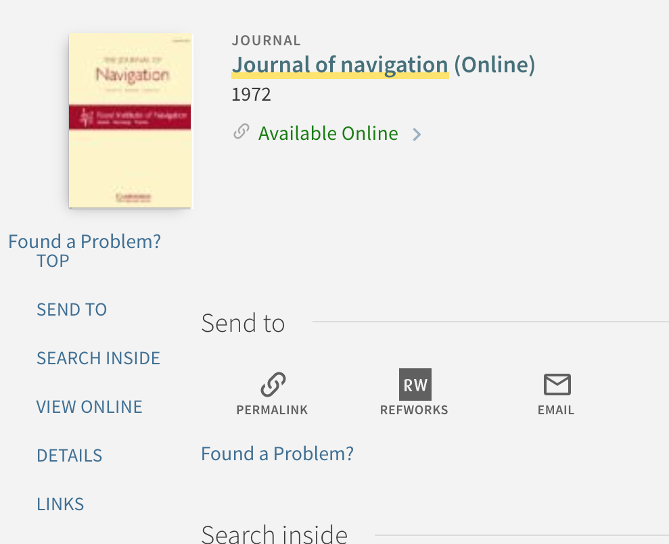
The “Found a Problem?” Link
The link appears in every possible section of the Primo detailed record, as the next slide illustrates....

Slide 6
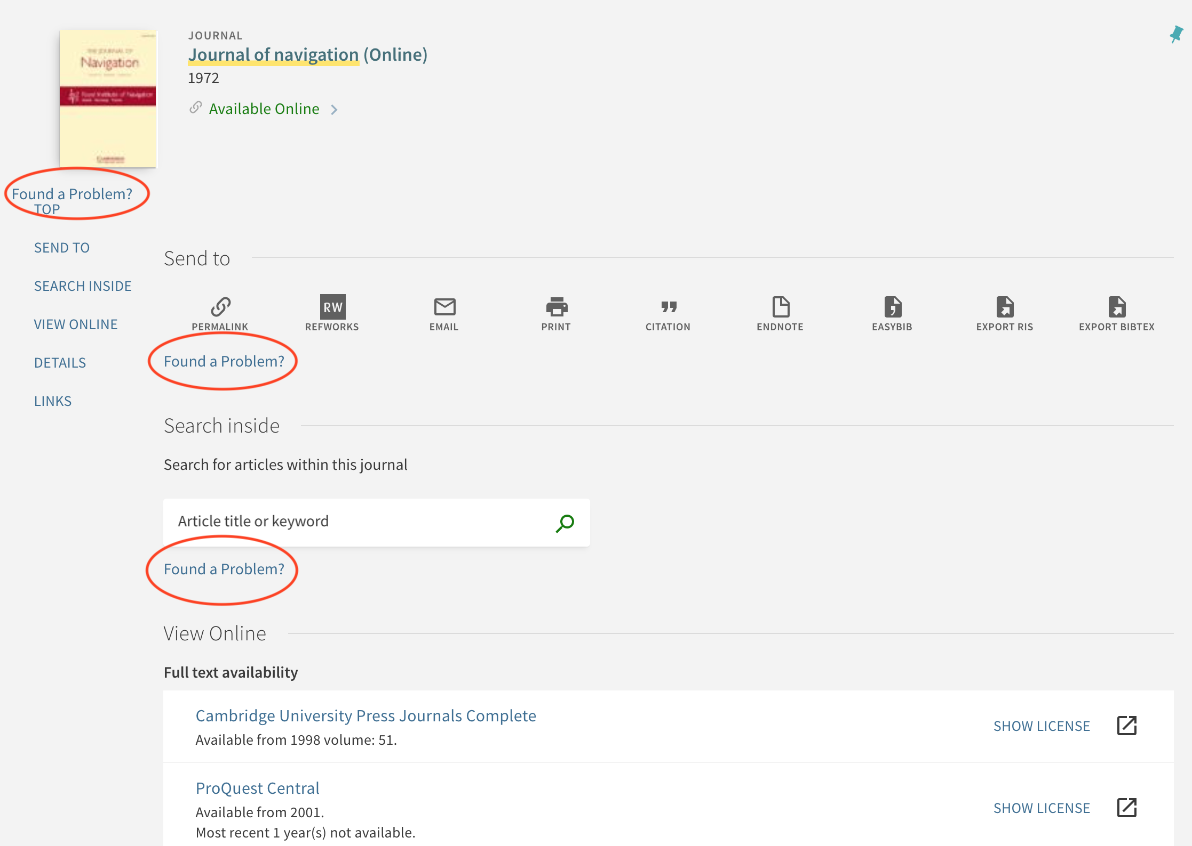
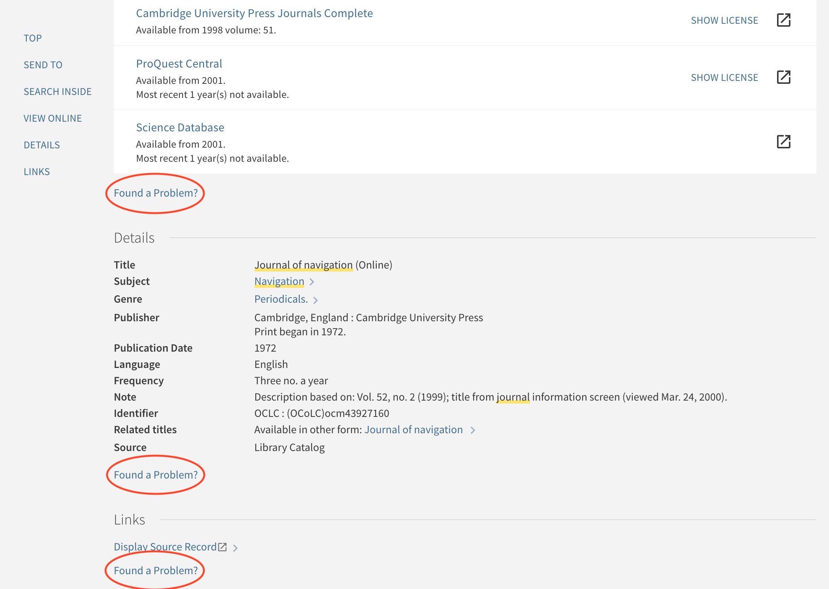
Many Found a Problem links!

Slide 7
The basic structure
Link in Primo → problem report form → email to ticketing system
Link: created in Primo Customization package using Javascript
Form: standard web form on our website
Ticketing system: Salesforce’s Desk.com (soon to be replaced)

Slide 8
Coding the Link
Inserted in the custom.js file in the local Primo Customization package
The actual code is on the next slide
Uses AngularJS. Two sections: one to extract the current URL and send it to the form, and one to insert the link into each section of the record
For instructions on creating local customizations for Primo, please see Ex Libris!

Slide 9
The actual code
/* Insert found a problem link */
app.controller('FullViewServiceContainerAfterController', [function () {
var vm = this;
function getPermalink() {
var currentURL = encodeURIComponent(window.location.href),
foundProblemForm = 'https://library.gwu.edu/found-problem';
foundProblemForm += ('?url=' + currentURL);
//return 'https://library.gwu.edu/found-problem';
return foundProblemForm;
}
vm.getPermalink = getPermalink;
}]);
app.component('prmFullViewServiceContainerAfter', {
bindings: { parentCtrl: '<' },
controller: 'FullViewServiceContainerAfterController',
template: '<a class="layout-align-left-left layout-column" id="found-problem" href="{{ $ctrl.getPermalink() }}" target="_blank">Found a Problem?</a>'
});

Slide 10
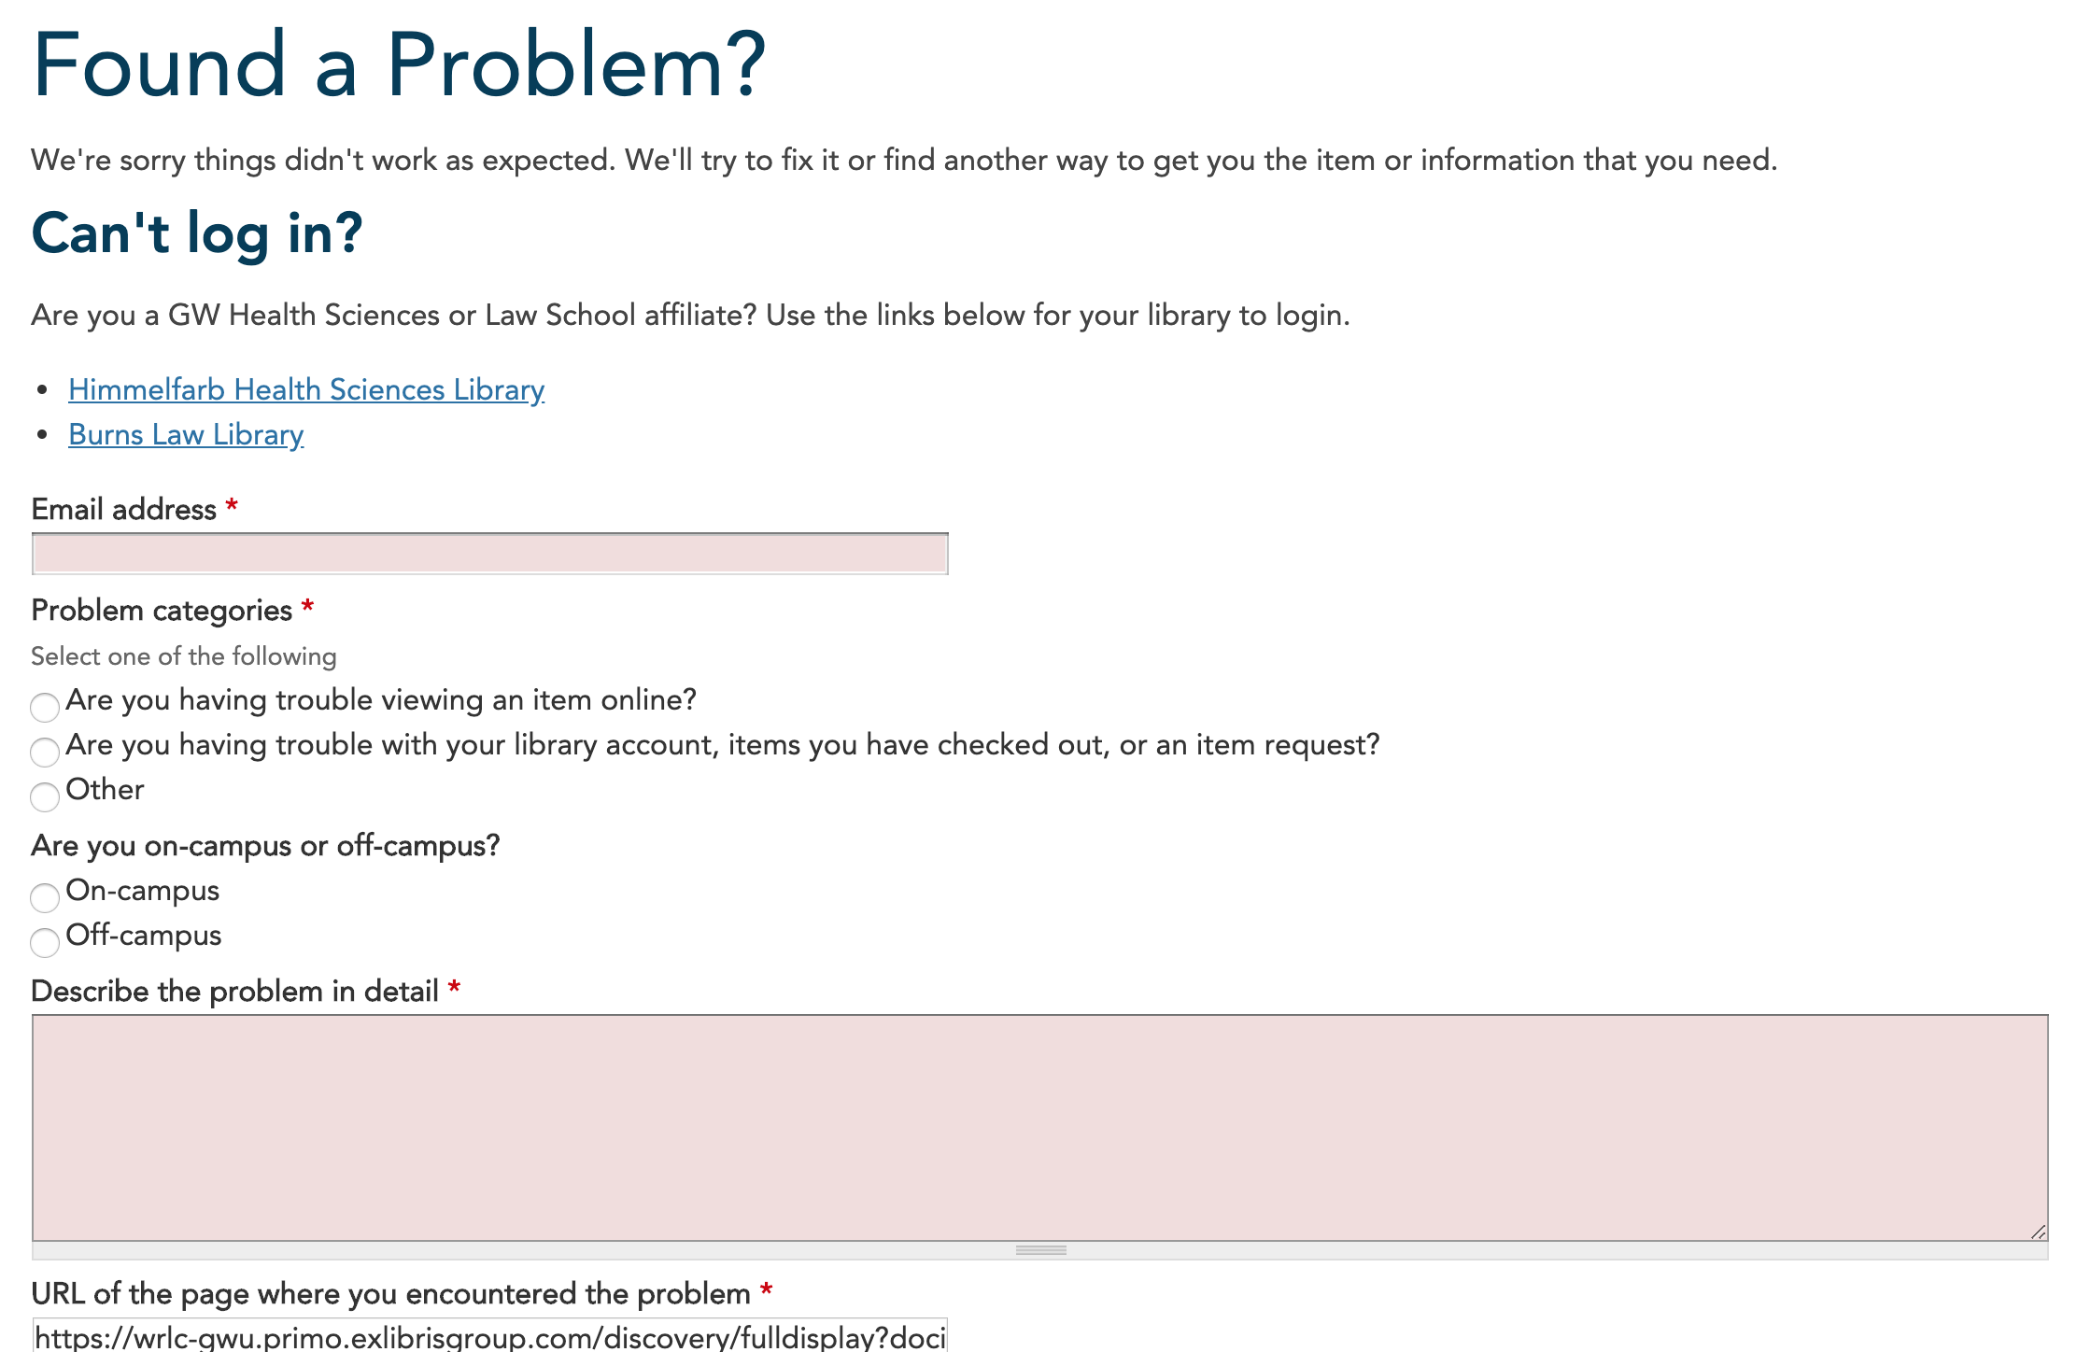
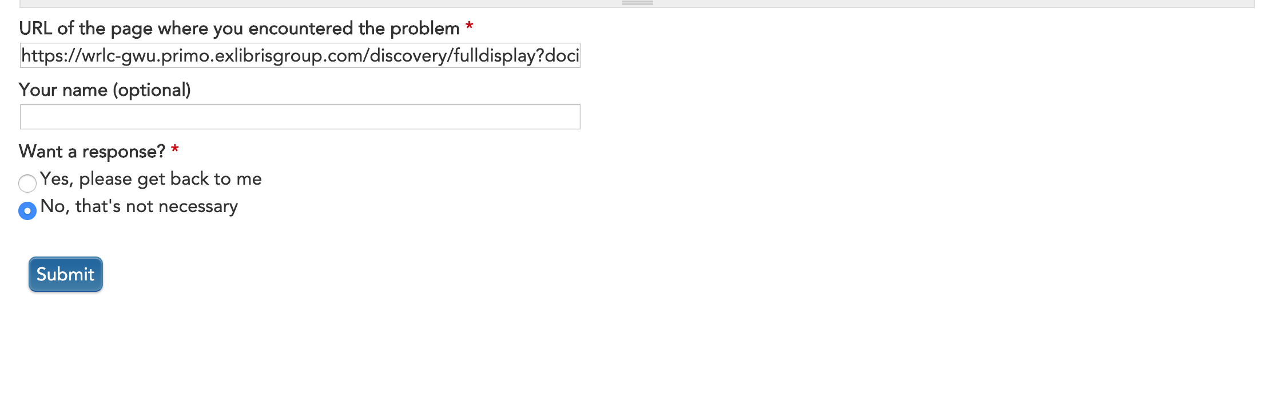
The Found a Problem form

Slide 11
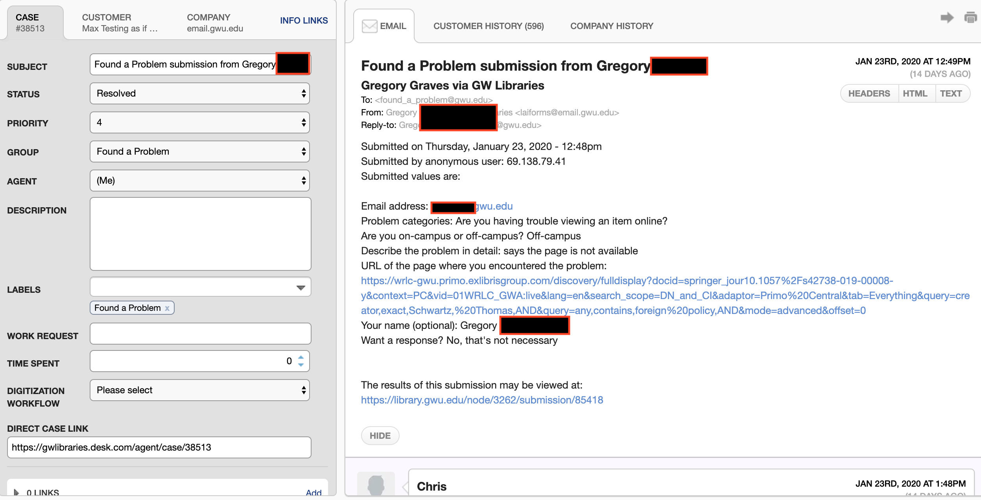
An actual ticket
Include a screenshot?

Slide 12
Why use a ticketing system?
Advantages:
Keeps all problem reports and replies in an organized, searchable database
Assigning tickets to staff provides accountability
Built in tools for managing group
Collecting reports in one place makes it easier to see trends and themes
Possible drawbacks:
Extra expense if you don’t already have one
Email-based ticket creation can lead to bogus tickets from bounced messages, etc.
Need to accommodate different people and departmental cultures in one system

Slide 13
Team Organization and Workflow
Cross-departmental Primo implementation team during early stages
Regular eresources team gradually took over after go-live
All group members receive alert when ticket is created; ticket is assigned based on time received
Tickets are transferred to other groups (cataloging, circulation, ILL) when needed
Discussions when developing our workflow:
What questions to include on form?
Can tickets be routed automatically based on those questions?
Should one person assign tickets?

Slide 14
Results: How has Found a Problem helped us?
Nearly 1500 problem reports received since go-live
Examples:
Feedback showed need for improved login process
Problem reports alerted us when Consortium Loan system broke down
One problem report that revealed a bug in Primo advanced search
Most problems are more routine, but still useful for spotting wider problems

Slide 15
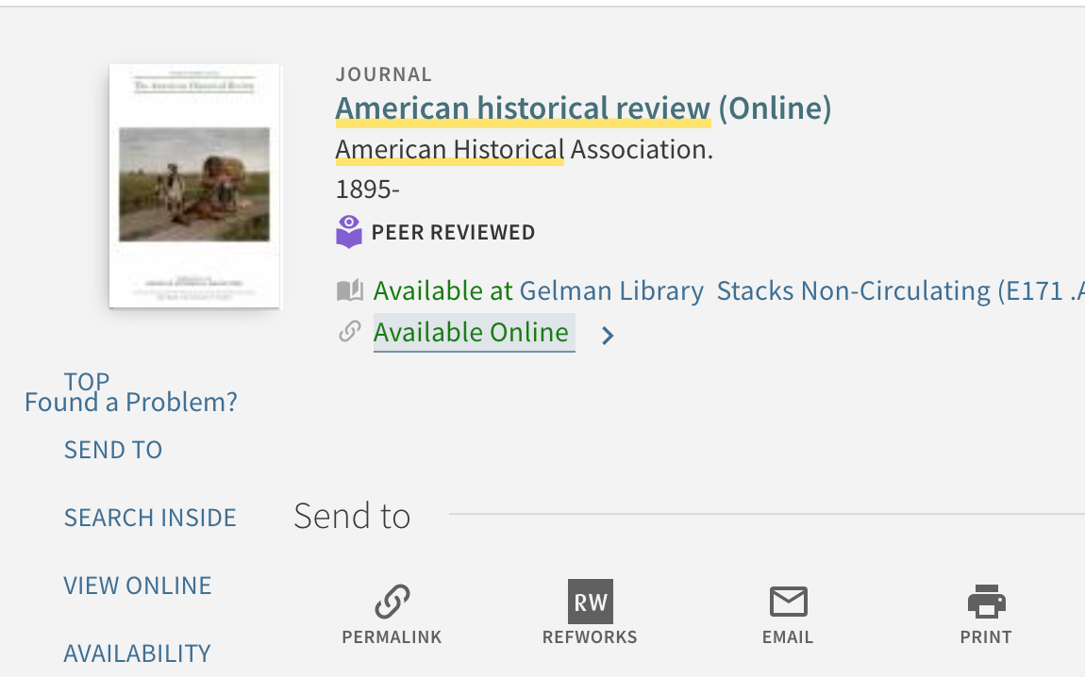
For the future
Desk.com being replaced by Service Cloud -- change workflows?
Further consideration and possible experiment with ideas like a coordinator to assign tickets or directing tickets automatically
Improve formatting of Found a Problem link to avoid display problems

Slide 16
Questions?
Contact Christopher Gross: chrisg@gwu.edu

